Slide 1
Business Management Workshop 2015
ROBINVALE COLLEGE - WATSONIA
Session Two

Slide 2
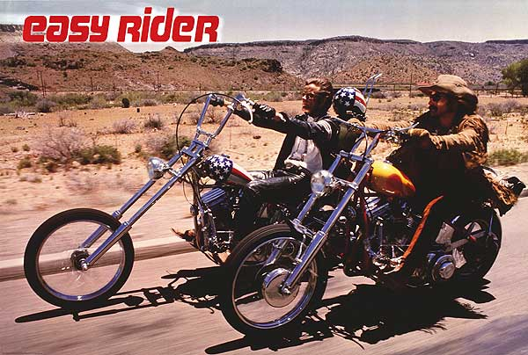
Unit 4 – we're rollin' again
Still fresh in your minds
Lets unpack the 2 areas of study
The Human Resource Function
The Management of Change

Slide 3
Area of Study One
The Human Resource Management Function
Large scale organisations operate with:
Land
Labour
Capital (finances, buildings & machines)
Labour is the Human Resources they use to complete their operations.

Slide 4
Human Resources are VALUABLE
Trained, happy workers are productive.
Productive workers help managers to achieve their objectives.
Lack of skilled labour will lead to production shortfalls, poor returns and high turnover.
Shareholders look at corporations with good HR backgrounds favourably

Slide 5
What Employees Want?
A good work environment that has safety as a priority
Money
A career pathway
Job Security
Work / Life Balance

Slide 6
HR and Ethics and Socially Responsible Management
Business Ethics has been covered extensively this year.
Realise - the meltdown of the European Union and slowing of the Chinese economy has caused our share valuations to fall extensively this year.
Don’t know what the European Union (EU) is?
Answer = a group of countries that joined together and have the same currency called the Euro.

Slide 7
Ethics and the EU, what have they got to do with management??
Ethics relate to the way a business is conducted.
If a company has plunging share prices, they may consider short term measures to ‘prop up’ their share valuations.
In the past, many directors used unethical measures to keep shareholders happy, James Hardy is a good example.

Slide 8
Ethics – How can I see it in action?
In Human Resource Departments we see the evidence of ethical organisations.
Equal Opportunity
Policies (Bullying, smoking etc)
Salary sacrificing
Unpaid leave
Training, Training, Training

Slide 9
Social responsibility in HR Management
Policies that allow employees to work for the community
Eg; CFA, Army reserve & St John Ambulance
Donations to charity
Membership of alliances like the Greenhouse Challenge for diesel users that want to lower their carbon footprint (Linfox)

Slide 10
Motivation Theories
Maslow
Herzberg
&
Locke

Slide 11
Maslow’s Theory
Hierarchy of needs
When base order needs are met we strive for the higher order needs
Management uses the Maslow reasoning to establish where each worker is at and then apply strategies to motivate them.

Slide 12
Herzberg’s Theory
Hygiene Factors that can cause dissatisfaction of workers
Don’t increase satisfaction but if lacking, cause dissatisfaction (money, conditions)
Motivating Factors for satisfaction of workers
Can increase satisfaction (achievement, recognition, responsibility)

Slide 13
Locke’s Theory
Management should be clear about their objectives before using motivation theories.
SMART objectives are favoured
Specific
Measurable
Achievable
Realistic
Time-Related

Slide 14
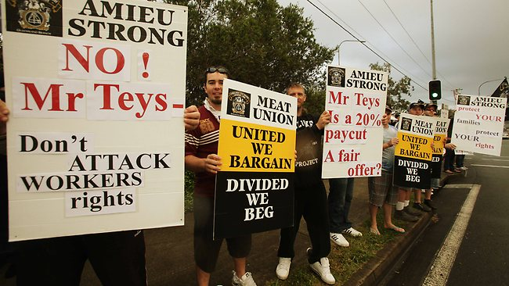
Lets have a revision exercise to ensure we know how to outline a motivation theory and apply it into practice.
Session 2 QUESTION ONE

Slide 15
The Employment Cycle
A cycle where employees join a large scale corporation, work for it and eventually depart.
Revise the way employees are hired, how their jobs are designed and the various induction processes involved.
Revise training and how it works for both the employee and the organisation.

Slide 16
The Employment Cycle
Revise appraisal methods for employee efficiency in the organisation
Revise the termination phase of the employment cycle and…….
recall why we need feedback from employees that leave our corporation.

Slide 17
Employee Relations
Also called Workplace Relations or Industrial Relations
Refers to how employees and employers negotiate about wages and conditions.
Lets have Employee Relations in a ‘nutshell’

Slide 18
Employee Relations in a nutshell!!!!
Enterprise Bargaining Agreements from the Howard era – still binding but not created anymore
Fair Work Act 2009 created by Gillard Labor Government and approves agreements and reviews awards.
Unions – still negotiate for members for conditions of work and wages
QUESTION 2 RELATES TO THIS TOPIC AND CAN BE DONE AT HOME FOR REVISION.

Slide 19
Area of Study Two
The Management of Change
Organisations that encompass change and adapt to the environment they operate in are successful in 2016.
Quite often a change in location, building or management can see an organisation prosper.
What is important, is how that change is managed.

Slide 20

Change in Organisations
The process that alters the current state of an organisation and leaves it in a new position.
Think about it, use a company you know as the example. Rays Outdoors was taken over by the Super Retail Group.
Sale price = A$50mil
Was this takeover a success or failure???????

Slide 21
Change in Organisations
Let’s not just talk it up, lets back it up!!!!
CEO Peter Birtles of the Super Retail Group has become the Australian CEO of the year.
Listen to the description of this manager and what makes him a leader of change.

Slide 22
The Forces that Drive Change.
Driving Forces apply pressure that creates a need for change to occur.
This decision is one that management must make carefully.
Driving Forces can come from the Internal Environment, the External Environment or the Macro Environment.

Slide 23

The Forces that Restrain Change
There are Restraining Forces that hinder the pressure for change in an organisation.
Restraining forces can also come from the Internal Environment, The External Operating Environment and the Macro Environment.

Slide 24
Change Management Strategies
Recall low risk and high risk practices for managing or avoiding change.
Risk, Risk, Risk!!!
A reduction in risk may be costly, but in the long term, more cost effective.

Slide 25
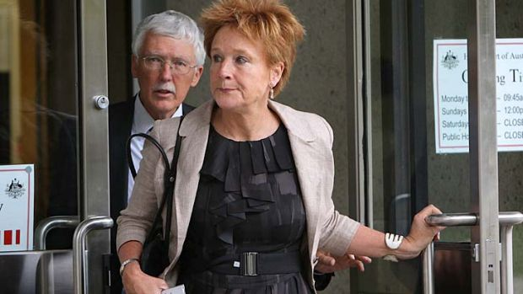
Change Management
James Hardie director M Hellicar was found liable of misleading and deceptive conduct.
Ms Hellicar tried to divert funds away from asbestosis sufferers after her company was found guilty of exposing customers to asbestos.
Times have changed, social responsibility is now a part of corporate life.

Slide 26
Kotter’s 8 step process
You have studied it, done a SAC with 2 questions on this and…………….. Forgotten it???
Kotter’s model is the one we need to know for the exam. Make some cue cards that summarise it and be prepared to apply it.

Slide 27
Issues in Change Management
Today, business is faced with many opportunities and threats that have the power to change it considerably.
Last night on the ABC news, a portion of the program was devoted to the way consumers are changing their buying patterns.
The modern consumer is buying more things online and having them delivered saving time and energy.

Slide 28
Issues in Change Management
Management must look at all areas that have the power to affect its operations.
Social Responsibility
Ethics
Globalisation
Technology
Law
Business Structures

Slide 29
Issues in Change Management
You have all looked at particular organisation and a change that is occurring in that industry or market
Keep this organisation in mind as you start to review past exams and do the practice exams in the coming revision periods

Slide 30
Question 3
If time permits, in groups of 2 attempt this question.
There is a solution guide at the back of the question sheets.

