Slide 1
Business Management Workshop 2016
ROBINVALE COLLEGE
Session One

Slide 2
Welcome VCE Candidates
Today’s workshop is designed to be interactive and you will have the ability to quiz the presenter.
There will be the provision of exercises to both stimulate and improve your skills related to:
The interpretation of possible examination questions
The application of key management concepts and how to use them appropriately.

Slide 3
Handouts from the Workshop
Each student should have a copy of the Practice Questions we will use in the revision of UNIT 3
The format for this revision session will be revising materials we have covered this year and then in small groups answering practice questions.

Slide 4
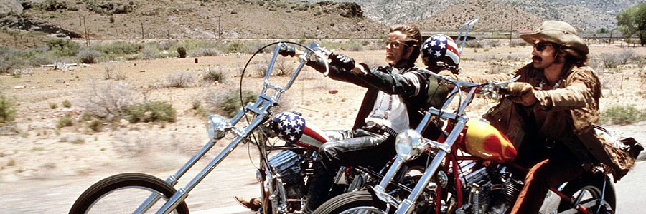
Unit 3 – Let’s Roll…..
There are 3 areas of study here to unpack.
Large scale organisations in context
The Internal environment of large scale organisations
The operations management function of large scale organisations

Slide 5
Large Scale Organisations in Context
Listed on the Australian Stock Exchange (ASX) – highly likely
> 200 people employed
Multiple locations for operations, headquarters and possibly overseas based.
Assets are substantial – refer to annual reports you have read.

Slide 6
Large Scale Organisations in Context
Ramsay Health
Woolworths
RM Williams
BHP Billiton
Billabong
Iluka
Super Retail Group (Ray’s Outdoors)

Slide 7
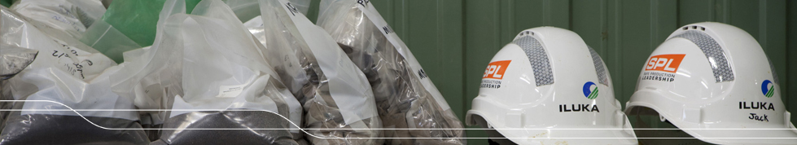
Large Scale Organisations
THE GOOD
Contribute to Australia’s Gross Domestic Product
Create Employment for many workers.
Contribute to our Balance of Payments
eg if the product is exported. (Balance of payments = exports minus imports)

Slide 8
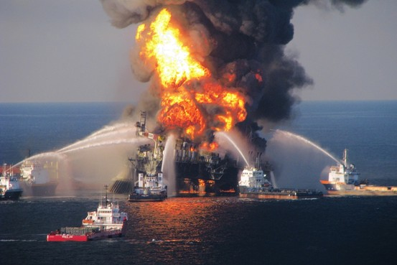

Large Scale Organisations
THE BAD
Negative Externalities.
Pollution
Control the prices in the market if the organisation is large enough.
Outsourcing eg sweatshops / child labour
Corporate Governance issues eg James Hardy and the asbestos compensation matter

Slide 9
Large Scale Organisations
Know the difference between an organisation that is in the PUBLIC SECTOR and one that is in the PRIVATE SECTOR.
Stakeholders?????? Who are they? There has always been an examination question that asks about these people, groups or organisations.

Slide 10
STAKEHOLDERS
Those that have an interest in an organisation.
Those that could be affected by decisions made by the large scale organisation.
In the exam, bring the stakeholders into context.
Look at the example given of the large scale organisation, its operation, location and environmental impact.

Slide 11

Key Performance Indicators - Financial
A way to measure the performance of a large scale organisation
Profit after tax
Sales (Rip Curl and the USA market)
Assets
Share prices
Market share (Iluka – biggest supplier of mineral sands in Australia)

Slide 12

KPI’s – Non-Financial
Usually found by surveying people.
Worker satisfaction
Customer satisfaction
Workplace accidents (recall the board at Carlton and United Breweries)
Greenhouse emissions

Slide 13
Practice Questions
In groups of 2 - 3 or individually, do the first 3 questions on the question sheet.
10 MINUTES

Slide 14
2. Internal Environment of Large Scale Organisations.
Management Structures = The Management Hierarchy
Management Structures outline communication flows, career pathways and power (hierarchy)

Slide 15
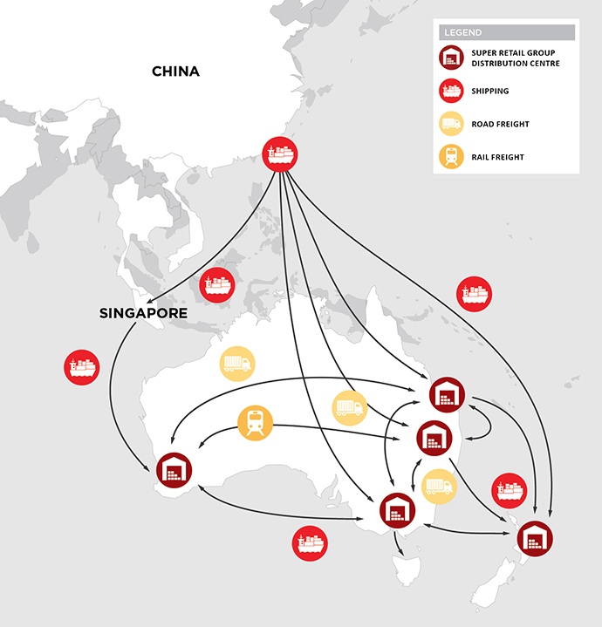






SUPER RETAIL GROUP

Slide 16
Management Structures
Know the models and how they relate to the product or service we are selling.
Be able to implement a management structure that will suit that product or service.
Be able to look at a scenario, look at the organisation involved and realise that one particular structure will suit it better than another.
Lets try!

Slide 17
Management Structure at Gathercole’s Abattoir Company. You Choose! Qustion4
Gathercoles Abattoir Corp is an ASX listed company. They process meat for local (Aust) markets and would like to expand the company and start exporting.
Compare and contrast two potential management structures that could help the company achieve this.
Which management structure would you recommend to the board and how do you justify this? (total 6 marks)

Slide 18
Management Structure at Gathercole’s Abattoir Company.
Look closely at the 2 parts to this question and realise what it is the examiner is asking you to do.
In groups of 2 – 3 or individually, write down your answers to this question which is Q4 on the question sheet (no dot points)

Slide 19
Management Structure at Gathercole’s Abattoir Company.
Refer to the 2010 assessment report.
Page 3
Question 4.
This question was closely based on this question and as we shall see, it was poorly answered in that year.
Lets unpack the answer.

Slide 20
3. The Operations Management Function
Planning
Organising
Leading
Controlling

Slide 21
Planning
Strategic – up to 5 years
Tactical – short term ( months to 2 years)
Operational - daily

Slide 22
Planning
SWOT analysis
Strengths
Weaknesses
Opportunities
Threats
Swot analysis is valuable for strategic planning

Slide 23
Organising
Coordinating resources
Achieving plans and objectives by ensuring the resources are there when needed.
Allocation of tasks.
Eg Iluka and the opening of their new mining plant in Balranald 2016. Includes environment impact studies, labour hire, stakeholder consultation, finance and materials movement.

Slide 24
Leading – How is this done?
Issue directives to subordinates (manager)
OR
Followed by employees (Leader)
Know the difference
What is it (LEADING)????
It is worth an extra A$200K per annum

Slide 25
Controlling
Bring in the changes
Monitor the changes
Evaluate how successful we are at achieving our goals and plans
Employees
Resource allocation

Slide 26
Management Style and Skill
Know the different styles and approaches.
Contingency or Situational Approach.
Managers use the style appropriate to the situation involved.

Slide 27
The Management Styles
Autocratic
Persuasive
Consultative
Participative
Laissez-Faire

Slide 28
Autocratic
The Good
Quick
Used in the army to advantage
The Bad
Employees lack input and may resent it
Morale and productivity can decrease

Slide 29
Persuasive
The Good
Quick
Managers can lead the decision making process
The Bad
No input from employees
Morale and productivity can decrease as a result similar to Autocratic

Slide 30
Consultative
The Good
Employees have an input at the decision making level and have ownership of the directives.
Used in workforces today
The Bad
Takes time
Can backfire if employees input is disregarded.

Slide 31
Participative
The Good
Morale boosting
Employees have high levels of ownership in the decision making process
The Bad
Takes time as in consultative process
May create disputes among employees

Slide 32
Laissez-Faire
The Good
With employees involvement at a high level, morale is often boosted.
Used at Google and similar large scale organisations
The Bad
Management lose a lot of control here
Employees may not get the direction they need to perform

Slide 33
Skills of a modern day Manager
Number 1 (Hughes’ Opinion)– Communicator. Good managers are great at this.
Negotiators
Time managers
Making decisions
Delegate authority
Analyse
IT skills are high

Slide 34
Operations Management Function
The management of the process that turns resources into Goods and Services.
Iluka
Mine at Ouyen extracts sand and turns it into 2 basic products.
These base products are trucked to Hamilton where they are separated into 4 products.
Final products exported to China from Portland.

Slide 35
Operations Management Function
The management of the process that turns resources into Goods and Services.
Ramsay Health Ltd
Provides Hospitals for the care of Patients.
Offers doctors, nurses and specialists who make that service possible.
Has accreditation to receive payment from private medical funds.

Slide 36
Productivity and Outputs
Production per worker over a period of time
Ramsay Health = how many beds were empty in each hospital.
Iluka = How much sand was shipped from Portland

Slide 37
Operations Management
This is a difficult area of the course and we will be doing several exam questions, a practice exam and other tasks associated with operations management.
Don’t panic.
Always look at what the inputs are, how they are processed and what is the end result (output).
LOOK THINK DISCOVER

Slide 38
Strategies, Ethics and Social Responsibility
Facilities design, realise its importance
Know the manufacturing layouts such as process layout, product layout and fixed-position layout.

Slide 39
Materials Management
Materials used in the input process must be managed carefully so that resources are allocated efficiently.
Understand all aspects of the materials handling processes such as JIT, TQM and QAS

Slide 40
VCE Business Management 2016
By now you will realise the importance of knowing about large scale organisations and how they are managed.
Their management isn’t by trial and error.
Management has been a science that has developed from the schools of economics and law over many years.
Management is a theory that is proven everyday in business practice.

Slide 41
Practice Questions.
Realise the importance of answering practice questions and handing them or emailing in to your teacher.
complete questions 5 and 6 at home for revision
BREAK

