Slide 1
VET SEMINAR 2015
Open for Business
The Certificate II in Small Business Operations and Innovation.
Peter F Hughes Loyola College
Watsonia

Slide 2

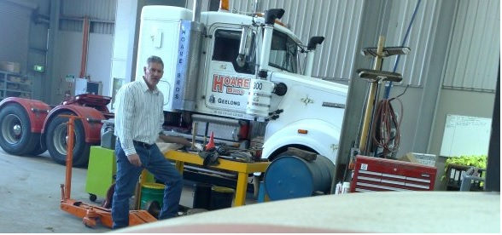
A History in Industry
A Future in Education
My career pathway has been in oil exploration and mining.
In 2010 I completed a Grad Dip Ed at Deakin University in Geelong.
This included a CERT IV in Training and Assessment
I am ideally suited to teaching the course that complements my student’s
own industry pathways.
The CERT II in Small Business

Slide 3
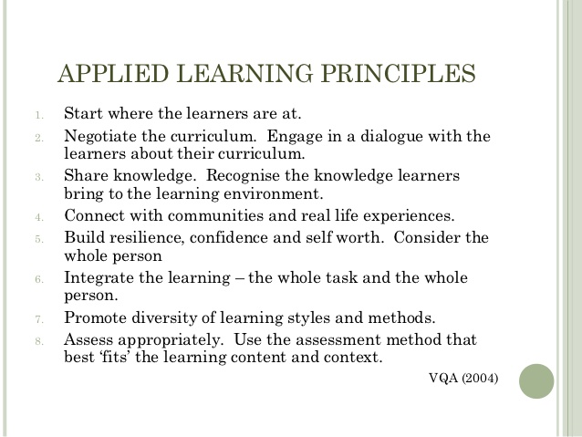
Some important principles to remember in VET

Slide 4
The Course and Unit Selection
Core units (Nine Compulsory)
VU21419 Contribute to small business operations and innovation
VU21420 Develop elementary professional skills for small business environments
VU21421 Follow small business policies and procedures
VU21422 Undertake basic market research and promotion for a small business product or service
VU21423 Contribute to small business planning
VU21424 Participate in small business quality and change processes
VU21425 Assist with the presentation of public activities and events
VU21426 Follow procedures for routine financial activities of a small business
BSBWHS201A Contribute to health and safety of self and othersFirst bullet point here

Slide 5
The Course and Unit Selection
Elective units (Choose Three)
BSBWOR202A Organise and complete daily work activities
SITXCCS303 Provide service to customers
BSBCRT301A Develop and extend critical and creative thinking skills
BSBINN201A Contribute to workplace innovation
BSBSUS201A Participate in environmentally sustainable work practices
ICAWEB201A Use social media for collaboration and engagement
FNSFLT301A Be MoneySmart
BSBPRO301A Recommend products and services
BSBSUS301A Implement and monitor environmentally sustainable work practices
FNSFLT401A Be MoneySmart through a career in small business

Slide 6
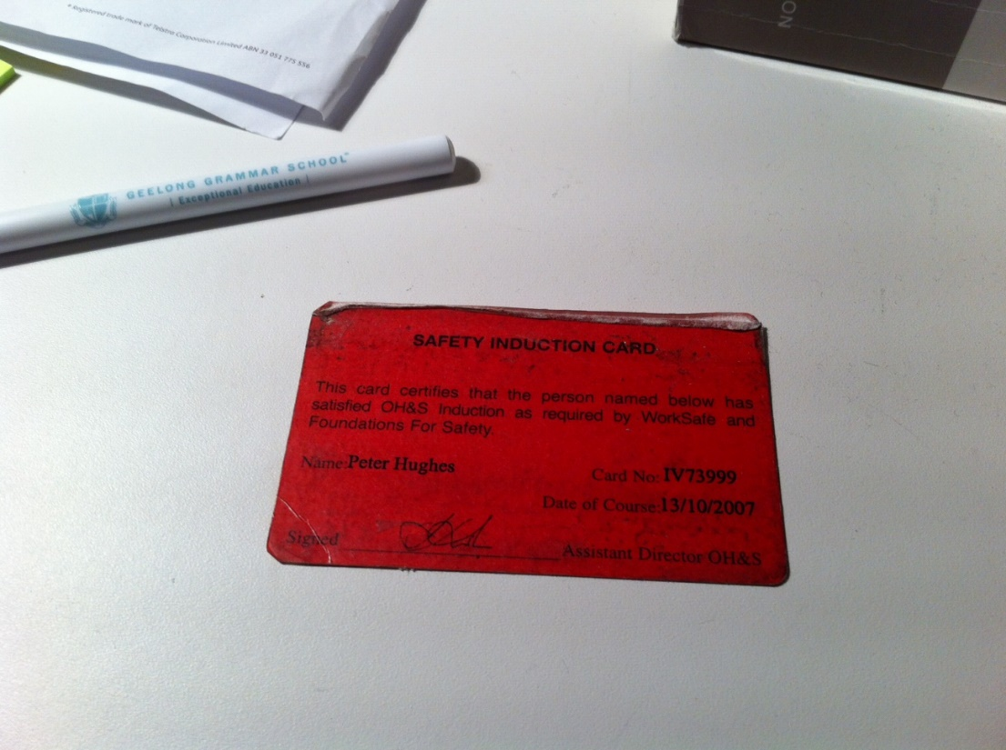
The Compulsory Unit to Start With
BSBWHS201A Contribute to health and safety of self and others
AN IMPORTANT UNIT THAT SETS UP THE COURSE.
KNOW YOUR STUDENTS, THEIR WORK PLACEMENTS AND THEIR PATHWAYS.
INDUSTRY INDUCTION CARD
FORMERLY THE RED CARD NOW WHITE.
IT MAY BE A COURSE THAT HELPS COMPLEMENT YOUR CERT IV

Slide 7

The Compulsory Unit to Start With
BSBWHS201A Contribute to health and safety of self and others
THIS YEAR IN FEBRUARY -17 OF MY 19 STUDENTS (IN YEAR ONE) DIDN’T KNOW WHAT ASBESTOS WAS.
OF THESE 17 STUDENTS – 5 BOYS IN PRE PLUMBING APPRENTICESHIPS
- 3 BOYS IN PRE CARPENTRY APPRENTICESHIPS
- 5 BOYS IN ELECTRICAL TRAINEESHIPS

Slide 8
The First Year – 6 units
LOOK AT WHAT THE STUDENTS ARE DOING IN SCHOOL BASED ACTIVITIES
SOME ACTIVITIES CAN BE OUTCOMES IN VET SMALL BUSINESS.
PLAN, PLAN, PLAN IN NOVEMBER WITH OTHER TEACHERS THAT HAVE YOUR STUDENTS.
THEIR OUTCOMES MAY COMPLEMENT AND ACHIEVE YOUR OUTCOMES
CONNECT WITH YOUR COMMUNITIES AND YOUR LLEN

Slide 9
The First Year – 6 units
START WHERE THE LEARNER IS AT
ONCE THE O H & S UNIT IS COMPLETED DESIGN YOUR ASSESSMENT TASKS SO THAT THE STUDENT STARTS TO BUILD THEIR SKILLS.
EACH UNIT SHOULD COMPLEMENT THE PREVIOUS ONE.
EACH REPORT, TASK OR PRESENTATION DONE BY THE STUDENT SHOULD SHOW IMPROVEMENT.
STUDENTS WHO ARE LEARNING QUICKER CAN HELP THEIR FELLOW STUDENTS TO CATCH UP. TOGETHER THEY MOVE AHEAD

Slide 10
HOW I DESIGN ASSESSMENTS
VU21420 Develop elementary professional skills for small business environments. (YEAR ONE)
VU21422 Undertake Basic Market Research and Promotion for a Small Business Product or Service (YEAR TWO)

Slide 11
HOW I DESIGN ASSESSMENTS
WORK WITH YOUR STUDENTS AND OBSERVE THEIR PROGRESS
HELP INCREASE THEIR SKILLS AND LET THEM TEACH YOU AS WELL
DESIGN YOUR ASSESSMENTS WITH THEM IN MIND.
CONNECT WITH OTHER VET TEACHERS IN CATHOLIC SCHOOLS AND SHARE RESOURCES AND ASSESSMENTS

Slide 12


RECORD KEEPING
‘GREAT, I WANT TO BE A VET TEACHER AND TEACH THIS COURSE.’
‘OH, THERE IS A BIT OF RECORD KEEPING?’
‘WHAT WAS I THINKING!!!!!!!!’

Slide 13
MY FAVOURITE UNIT
ICAWEB201A - Use social media tools for collaboration and engagement
https://mitropoulosd.wordpress.com/issues-in-social-media/

Slide 14
FIND ME
http://peterfrancishughes.com/
peter@peterfrancishughes,.com
hughesp@Loyola.vic.edu.au

