Slide 1
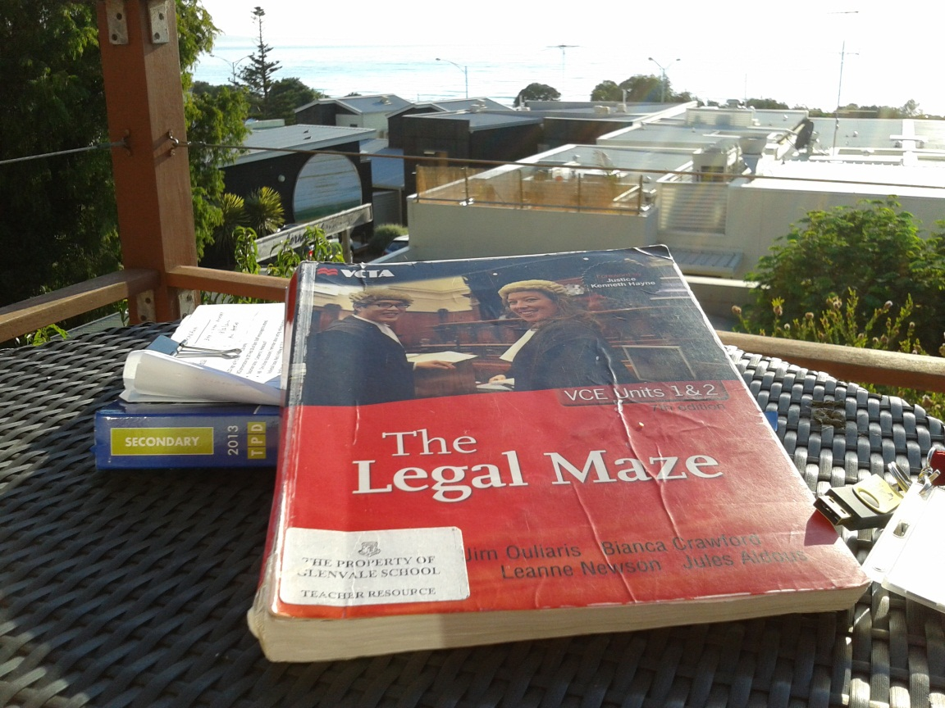
VCE Year 11
Legal Studies Unit 1
Chapter TWO Part (ii)
LAW MAKING: PARLIAMENT AND SUBORDINATE AUTHORITIES

Slide 2
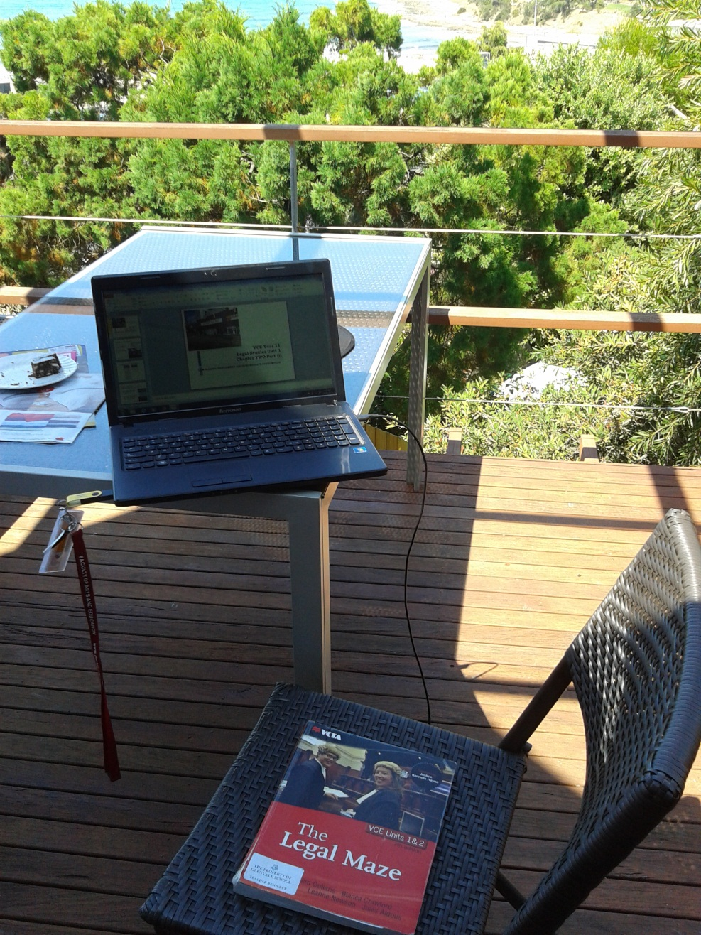
Your legal Studies homework
By now you should have completed workbook Number 1
Your poster should be on its way to Melbourne.
Your notes on chapter 1 are complete and comprehensive.
Over the weekend you started to read Chapter 2 in preparation for these slides today.

Slide 3
The Road Ahead
Week 3 & 4 we will be completing Chapter 2
Week 4 will see you receiving a ROADMAP on how we will be approaching our run up to the First SAC.
Week 5 will see the first SAC for Unit One

Slide 4
Parliament – Just what does it do?
Makes laws
Checks the laws made by delegated authorities
A place for debate and discussion
Government functions are scrutinised

Slide 5
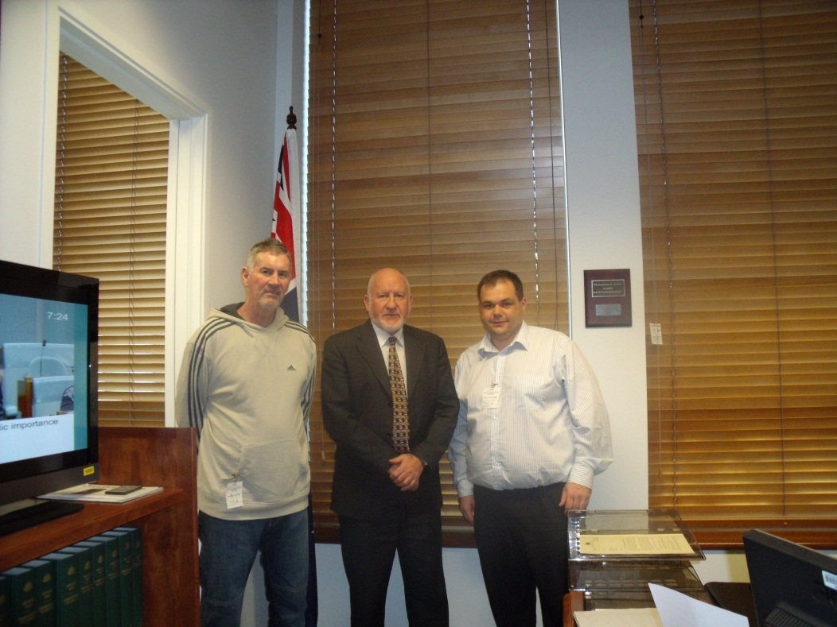
Parliament as a Law maker
Legislative process is the way Parliament makes laws.
Both State and Federal parliaments do this as their main role.
Political parties that form government have agendas that
they implement when they are elected to power.
JOHN FORREST MP BROUGHT LEGISLATION TO THE LOWER HOUSE THAT SAW A BILL ENACTED TO BUILD A PIPELINE FOR WATER FROM THE GRAMPIANS TO MILDURA.

Slide 6
LEGISLATIVE PROCESS
Consists of 3 readings in each house of Parliament
The bill that is being read has been drafted by a government lawyer who aims to ensure that the legislation to be enacted is within the constitution.
Because the Lower House of parliament forms government, most bills start there.
Refer p 34 Weapons Act

Slide 7
LEGISLATIVE PROCESS
Note the order and types of reading of bills on p36
Note that Royal Assent is required to enact the legislation
Refer to the DVD ‘Making a law’
Please summarise this procedure as you will be examined on it.

Slide 8
Case Study –Reclaiming the Streets
P38 - 40
Read together

Slide 9
Delegated law making authority
The ability of parliament ot grant law making authority to other bodies.
Ensures parliament can use its time wisely and concentrate on the most essential needs of the community.
Any legislation made by subordinate authorities can be reversed, overridden or removed.

Slide 10
Federal delegated powers
Statutory Authorities
Government Departments
Working for the Federal government

Slide 11
State Government delegated authorities
Local councils
Govt departments
Statutory authorites
Working for the state government

Slide 12
Statutory Authories
FEDERAL GOVERNMENT
Australia Post
STATE GOVERNMENT
Vicroads

Slide 13
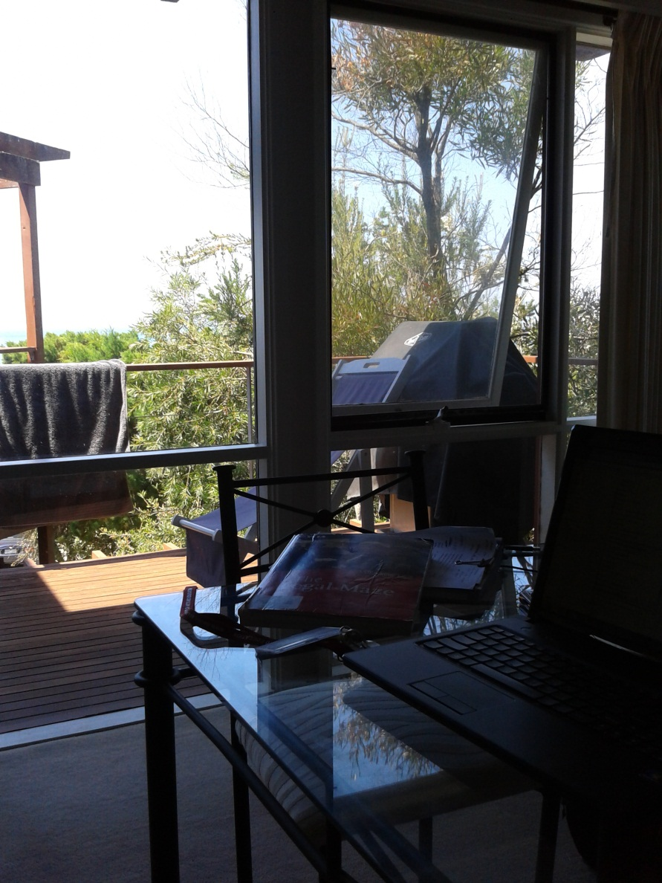
HOMEWORK
Ensure your notes are up to date on Statutory authorities and how they operate.
Make sure you have created some diagrams on how a law is made and the various steps taken for it to be passed as legislation.
Note; All three bodies of parliament are involved in the law making process.

