Slide 1
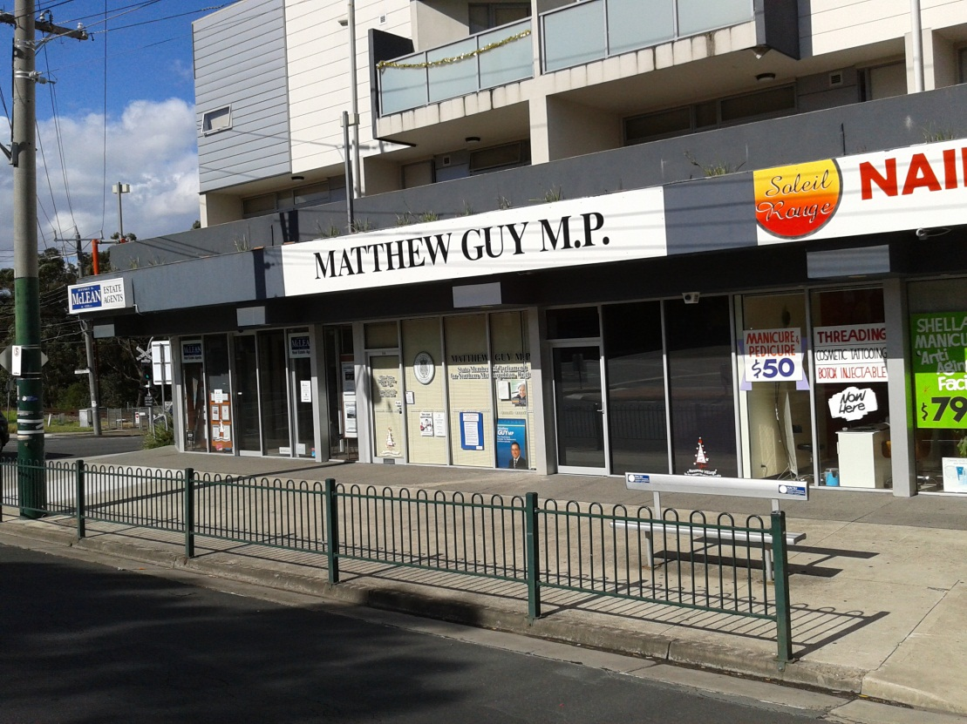
VCE Year 11
Legal Studies Unit 1
Chapter TWO Part (i)
LAW MAKING: PARLIAMENT AND SUBORDINATE AUTHORITIES

Slide 2
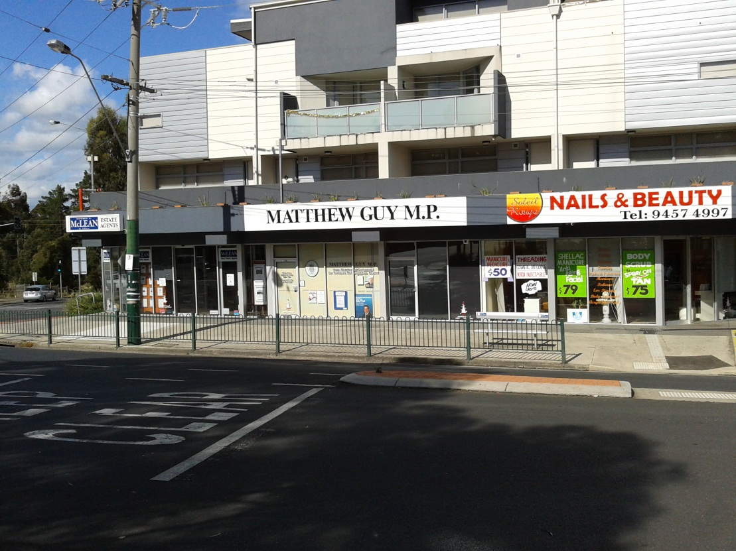
CHAPTER 2 LAW MAKING
OUTCOME
The role and characteristics of Parliament in law making.
The role of subordinate authorities in the law making process.
Office of Matthew Guy (Member of Parliament) State Government of Victoria.
Minister of Planning
Liberal party

Slide 3
How the Law is made in Australia
Statute law
Made by Federal Parliament
Made by State Parliament
Common Law
Judge made Law
Made by Subordinate Authorities

Slide 4
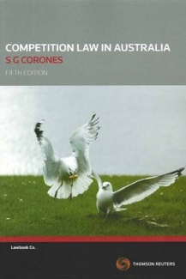
The Sources of Law
Parliament creating Acts, Statutes and Legislation
Commonwealth, State and the
Territory Parliaments all have
sovereignty.
Parliamentary Sovereignty means
they have the ultimate power in
making laws in their areas.

Slide 5
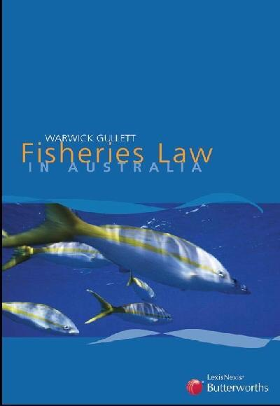
The Sources of Law
What does parliamentary sovereignty mean?
Each parliament can create laws
providing it is within our
constitution.
Each parliament can over ride
previous rules by changing or
repealing an act of parliament.
Common law can be legislated
against.

Slide 6
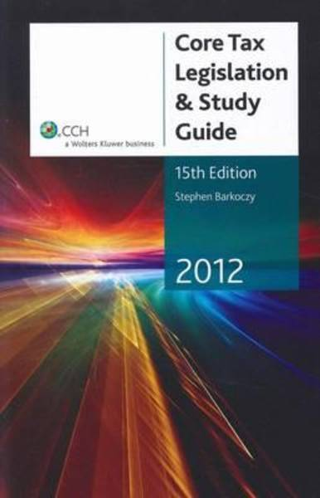
The Sources of Law
Confusing?????
Each Parliament operates within its jurisdiction.
Elected governments main role is to make laws.
Laws are also often changed to keep abreast of the changing times.
The Australian taxation legislation is complicated and longwinded.

Slide 7
The History of Australia in a NUTSHELL.
Federation of the states in 1901 was required for the security of our growing nation.
Commonwealth of Australian Constitution Act (Cth) 1900 was the document that allowed the states to Federate.
This document sets out what areas the Commonwealth has the power to legislate in.
The remaining powers of law making were left with the states and territories
EASY EASY EASY

Slide 8
The History of Australia in a NUTSHELL.
WHY A FEDERATION?????????
The states and territories were concerned with various matters that existed while they were separate colonies.
DEFENCE
SOCIAL SECURITY
TAXATION
CURRENCY
LET’S MOVE AHEAD AS ONE COUNTRY

Slide 9
FEDERATION AND ITS RESULT
THIS AMALGAMATION OF THE STATES UNDER A CONSTITUTION CREATED THE FOLLOWING DIVISION OF POWERS
Law making powers for the Commonwealth
Law making powers for states and territories
A High Court of Australia that could resolve differences between the states and the Commonwealth should a dispute erupt in those divisions of power.

Slide 10
SPECIFIC POWERS
Sections of the constitution relate specifically to the Commonwealth parliament and what it can legislate for.
FOREIGN TRADE
TAX DEFENCE

Slide 11
EXCLUSIVE POWERS
Other sections of the Commonwealth Constitution outline those powers that are the excusive powers of the Commonwealth parliament.
DEFENCE
IMMIGRATION
PRINTING MONEY

Slide 12
CONCURRENT POWERS
Powers that are shared between the States and the Commonwealth.
TAXATION
state
Land Tax
Probate (wills)
Clth
Income Tax
Mining tax

Slide 13
CONCURRENT POWERS
IF THERE IS A DISPUTE ABOUT CONCURRENT POWERS BETWEEN THE STATES AND THE FEDERAL GOVERNMENTS????
FEDERAL LAW PREVAILS
EXAMPLE: High country grazing rights of alpine cattlemen.

Slide 14
RESIDUAL POWERS
ANY POWER NOT SPECIFICALLY GIVEN TO THE COMMONWEALTH IN THE CONSTITUTION REMAINED WITH THE STATES AND TERRITORIES.
THEY ARE RESIDUAL AND TIGHTLY HELD BY THE STATES.
CRIMINAL LAW
HEALTH
EDUCATION

Slide 15
The Structure of Parliament
Australian Federal parliament and the Victorian parliament is based on the Westminster system.
Bicameral parliament meaning 2 houses.
Upper and Lower house.
Includes the Crown and their representative

Slide 16
Parliament Structure
The Crown
Upper House
Lower House

Slide 17
THE CROWN
The British monarchy is our traditional head of State.
Queen Elizabeth
Her representative in Canberra as the head of state is the Governor General
Her representative in Victoria as head of state is the Governor

Slide 18
House of Representatives
THE LOWER HOUSE
150 MEMBERS
ELECTED FOR 3 YEARS
Represents the interests of the majority of Australians

Slide 19
The Senate
THE UPPER HOUSE
MEMBERS ARE ELECTED FROM ALL PARTS OF AUSTRALIA
ENSURE THE STATES AND TERRITORIES ARE WELL REPRESENTED IN PARLIAMENT
6 YEAR TERMS

Slide 20
VICTORIA – OUR STATE
UPPER AND LOWER HOUSES
LOWER HOUSE IS LEGISLATIVE ASSEMBLY
UPPER HOUSE IS LEGISLATIVE COUNCIL

Slide 21
VICTORIA – OUR STATE
LEGISLATIVE ASSEMBLY
88 MEMBERS WHO REPRESENT THE POPULATION
LEGISLATIVE COUNCIL
40 MEMBERS (5 FOR EACH REGION)

Slide 22
THE FORMATION OF A GOVERNMENT
Note:
Parliament (Federal)is a building which contains:
The Governor General
The Lower House of Parliament
The Upper House of Parliament

Slide 23
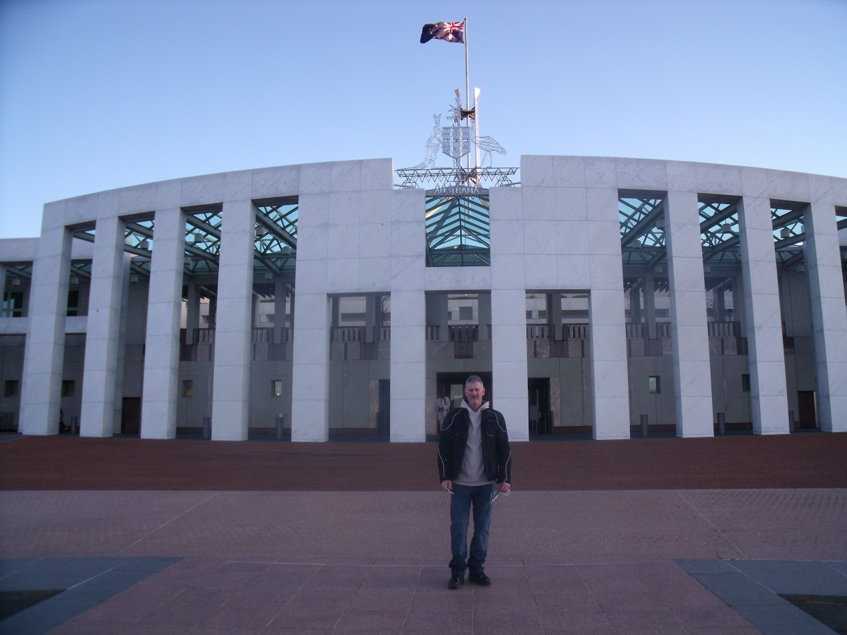
Parliament House
Parliament and Government are not the same thing.
This is an important concept to understand.
Think of it as a big house with lots of people who all represent someone who has elected or appointed them.

Slide 24
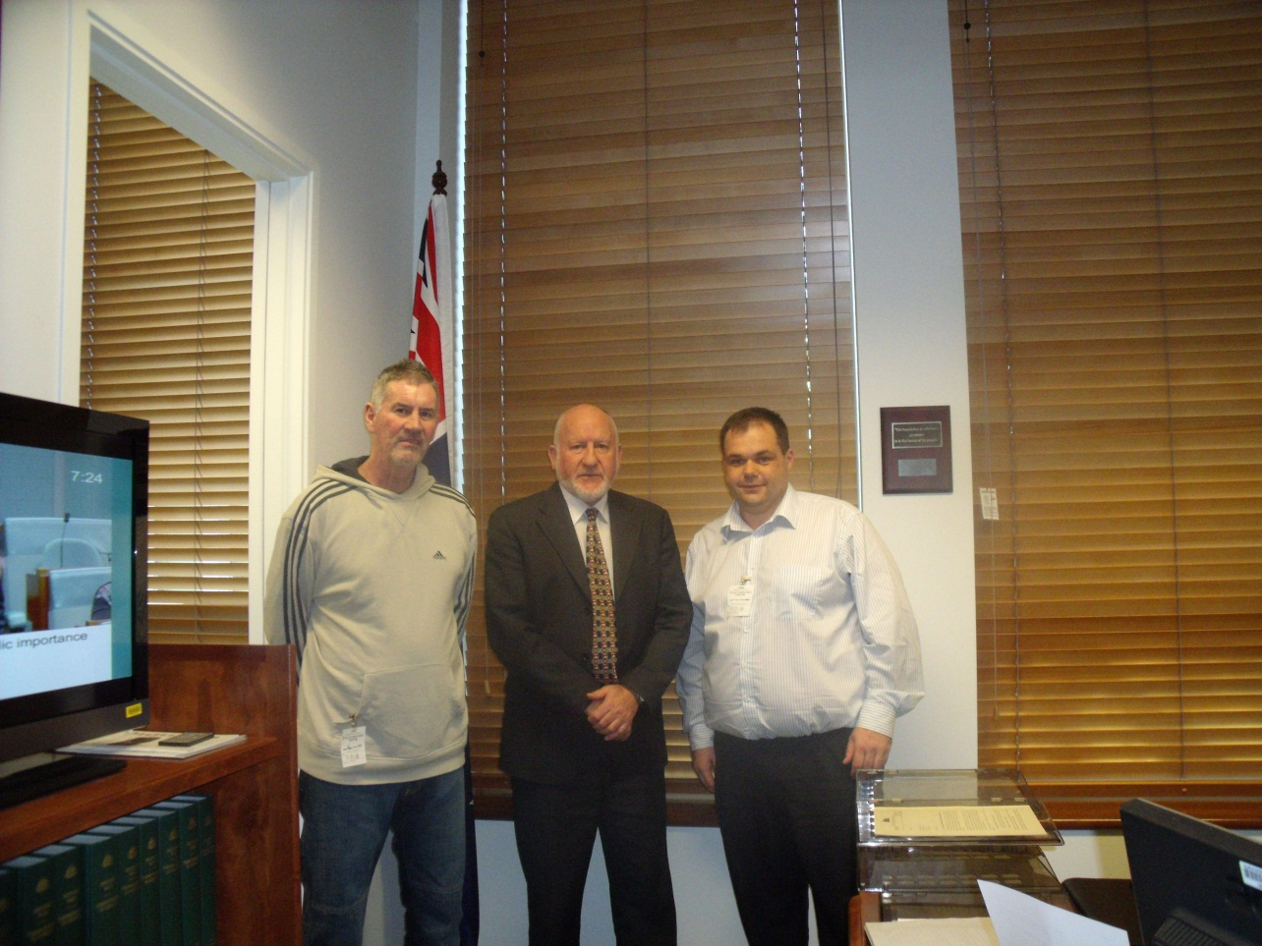
Parliament House
Who works in parliament House
The Honorable John Forrest MP
House of Representatives Member for The Mallee
Political Party = The Nationals
They are in oppostion.

Slide 25
Parliament House
Who works in parliament House
The Honorable John Forrest MP
An elected member for 19 years.
Joined the Nationals in Mildura over 25 years ago where he was working as a civil engineer.

Slide 26
Parliament House
Who works in parliament House
The Honorable John Forrest MP
Spends time in Canberra when Federal Parliament is sitting.
Has an electoral office in Swan Hill and Mildura where he works during non-sitting times of parliament.

Slide 27
Review
We have covered some new concepts and terms today.
Ensure you have drawn diagrams to cover these concepts.
Bring your book of new words and terms up to date up to date.
Read ahead for the next lesson

